Slide 1
Energy Consumption Analysis

Slide 2
Objective
Analyze energy consumption data to identify patterns and trends.
Validate assumptions using statistical tests:
1- Region's impact on energy consumption.
2- Relationship between time of day and energy consumption.
Recommend a threshold for low-consumption cells to optimize usage.
Calculate potential savings in kWh and EGP through optimization.

Slide 3
Data Cleaning
Handling Missing Data:
Filled missing timestamps with interpolated values.
Replaced missing values in KWH/hh (per half hour) with the median of the respective cell.
Outlier Removal:
Used the IQR method to identify and remove extreme outliers.
Data Type Corrections:
Converted DateTime to a proper datetime format.
Ensured numeric columns (cost, New_KWH/hh (per half hour)) were correctly typed.

Slide 4
Data Cleaning cont.
Column Cleaning:
Standardized column names by removing leading/trailing spaces.
Ensured consistency in names for easier analysis.
Categorical Data Cleanup:
Validated categorical variables (e.g., region, TimeOfDay) for consistency.

Slide 5
Dataset Overview after Cleaning:
Number of rows: 1,436,640
Key variables: KWH/hh_(per half hour), cost, region, TimeOfDay, Consumption_Category

Slide 6
Feature Engineering:
New Features Created:
Cost Per kWh: Calculated cost for each consumption period using a dynamic pricing model.
Time-Based Features:
Extracted Hour, Day, Month, Year, and DayOfWeek from the DateTime column.
Categorized times into TimeOfDay (e.g., Morning, Afternoon, Evening, Night).
Season Classification: Classified months into seasons (e.g., Winter, Summer).
Consumption Category: Grouped consumption into Low, Normal, and High based on thresholds.
Purpose:
Enhance the dataset with meaningful features for better insights and analysis.

Slide 7
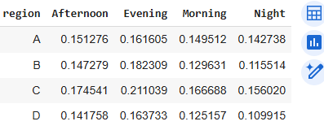
Data useful business insights
Energy Consumption by Time of Day
* Evening generally has the highest energy consumption across all regions.
* Night consistently has the lowest consumption, indicating off-peak usage.
* Region C shows the highest variability in consumption across different times of day.

Slide 8
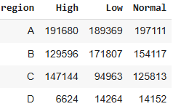
Data useful business insights
Energy Consumption Categories by Region
* Region A: Balanced across all categories.
* Region B: More Low consumption.
* Region C: Mostly High consumption.
* Region D: Predominantly Low consumption with very few High entries.

Slide 9
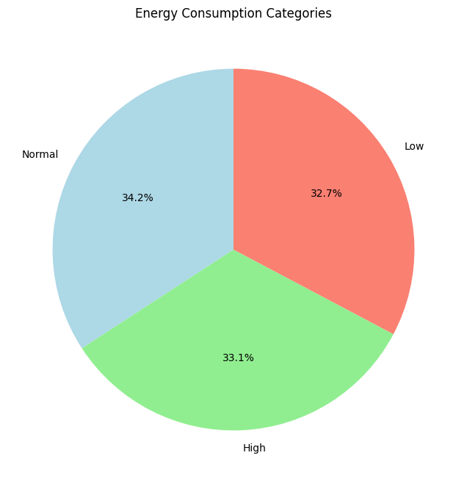

Slide 10
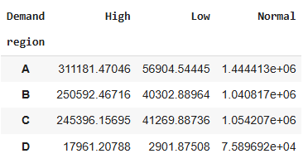
Data useful business insights
Total Cost by Region and Demand
* Normal consumption has the highest demand in all regions.
* Region D has the lowest overall demand, especially for High consumption.

Slide 11
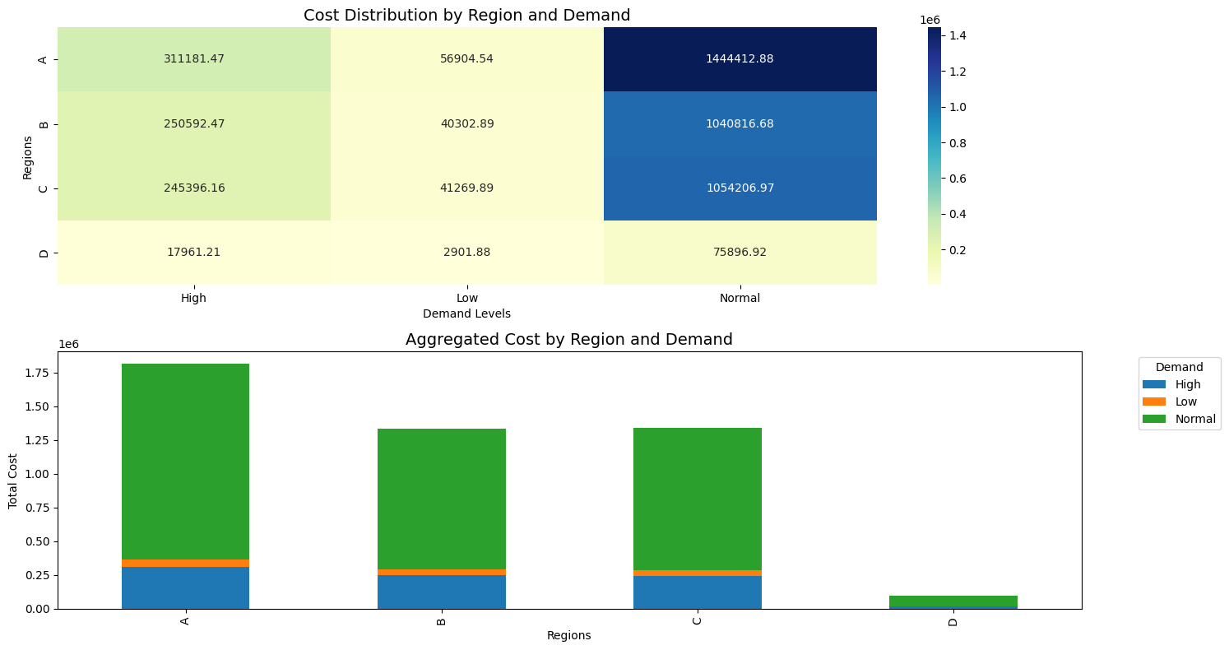

Slide 12
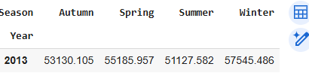
Data useful business insights
Seasonal Energy Consumption
Peak Consumption: High in January and December.
Low Consumption: In June and July.
Actions:
Focus on energy savings in low-demand months.
Adjust pricing based on seasonal demand.

Slide 13
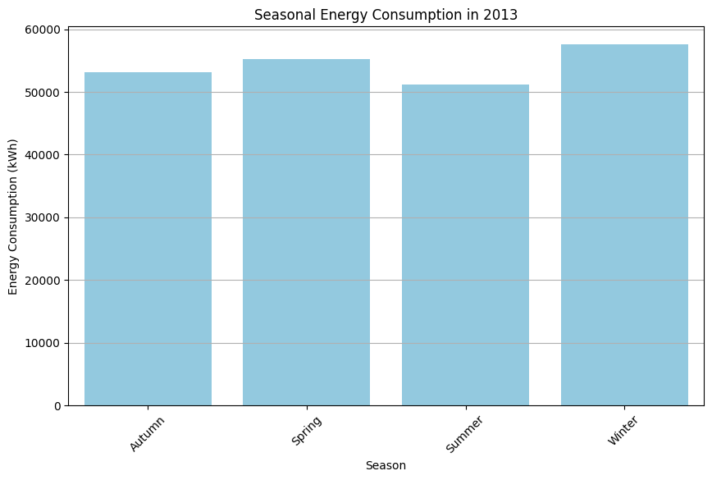

Slide 14
Data useful business insights
Summary:
Evening has the highest consumption, while Night has the lowest.
Region C shows high variability in consumption.
Seasonal trends: Higher demand in winter, lower in summer.
Next Steps:
Implement energy-saving strategies during low-demand months and regions.
Use insights to adjust pricing and optimize capacity.

Slide 15
ANOVA Test
Objective: Test if there is a significant relationship between region and energy consumption.
Result:
p-value: < 0.05
Decision: Reject H₀.
Conclusion: There is a significant relationship between region and energy consumption.
ANOVA Test Limitations:
Lacks Pairwise Comparisons: Does not provide specific relationships between individual groups. Requires a post-hoc test.
Numerical Data Only: Cannot analyze categorical data directly.

Slide 16
Chi-Squared Test
Objective: Test if there is a significant relationship between TimeOfDay and energy consumption categories.
Result:
p-value: 0.0
Decision: Reject H₀.
Conclusion: There is a significant relationship between TimeOfDay and energy consumption.
Chi-Squared Test Limitations:
No Pairwise Comparisons: Similar to ANOVA, Chi-squared only tests overall independence.
Categorical Data Only: Requires data to be grouped into categories and cannot handle numerical data directly.

Slide 17
Choosing Threshold and Its Impact
Threshold:
Set at the 33rd percentile: 0.0830 kWh.
Impact:
Low Consumption Cells: Identified cells below the threshold.
Total Cost Saved: EGP 403,437.36.

Slide 18
Thank You

